Slide 1

Legend Detection

Slide 2
INVESTIGATORS
Yu Hou
Student
Faculty of IT
Monash University

Slide 3
Abstract
Background: The goal of this project is to create a tool to recognize legends in floor plans, which enables to generate accessible graphics speedily. Legend detection has received a considerable less attention from researchers, so this project also involves creating a floor plan corpus.
Method: Use OCR (Optical Character Recognition) software on connected components, then connect symbols with texts, before finally filter out the outliers.
Conclusion: The tool can detect and extract symbol-text type legends with ~83% precision and ~88% recall. However, this tool performs poorly on floor plans containing table type legends and mixed type legends.
Implications: may be used to generate accessible graphics; the tool can be used as a baseline for other researchers to create a better recognition tools; a corpus of floor plans with legends.

Slide 4
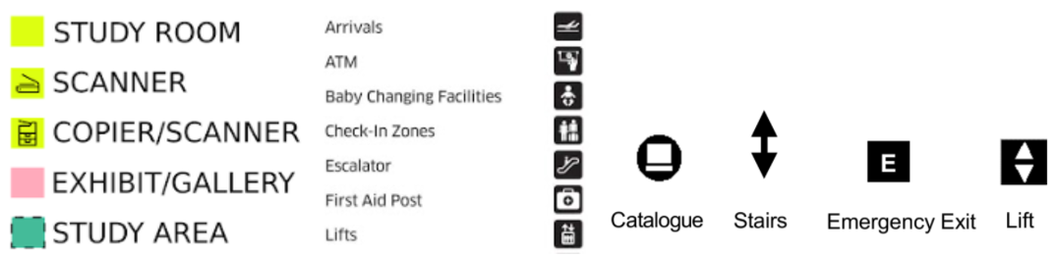
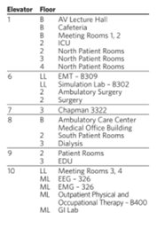
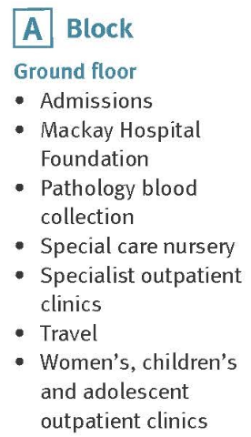
Types of legends
Ordinary:
Table: Bullet points:
Notes:
Recognition result is bad for low resolution images and if different types of legends exists in the same floor plan

Slide 5
Background / Aims
Information graphics can vary from charts, molecule diagrams, house plans to public space floor plans. Most of such graphics contain a legend/key to support interpretation. Graphic recognition researchers have focused on automatically recognizing such graphics for varying purposes and one such important purpose is accessible graphic generation. However, generating accessible versions of floor plans using graphic recognition would be complex due to varying symbols. A major step that can considerably reduce this complexity is to recognize their legends.
Key aims:
Creating a corpus of public space floor plans that contains legends
Creating an automated tool to recognize legends in floor plans, which returns the location of symbol and its meaning.

Slide 6
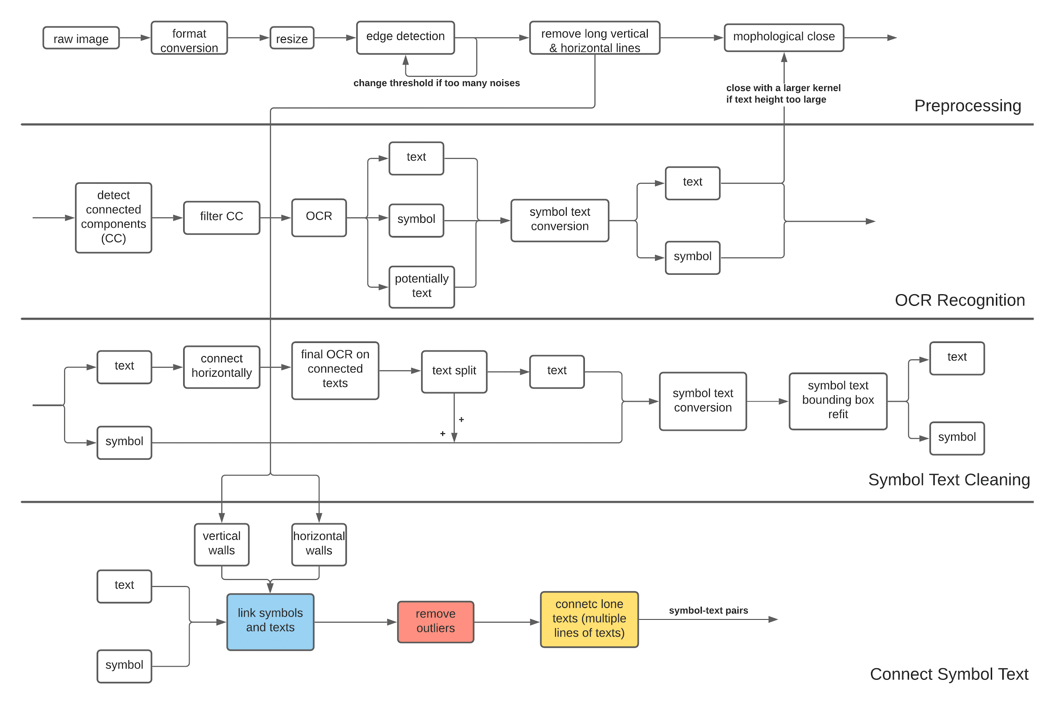
Methods

Slide 7
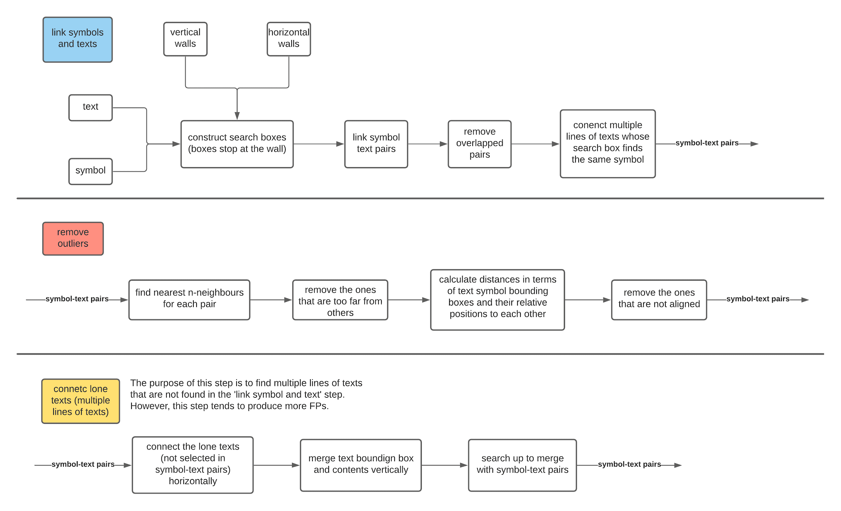

Slide 8
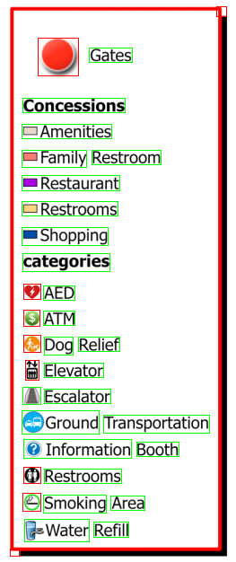
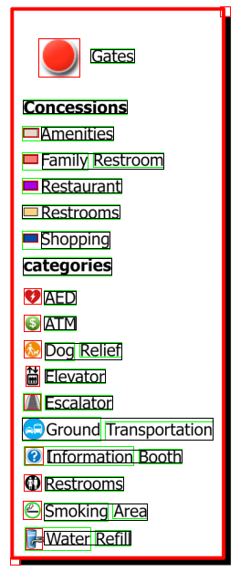
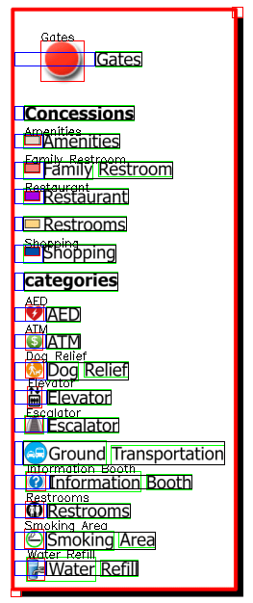
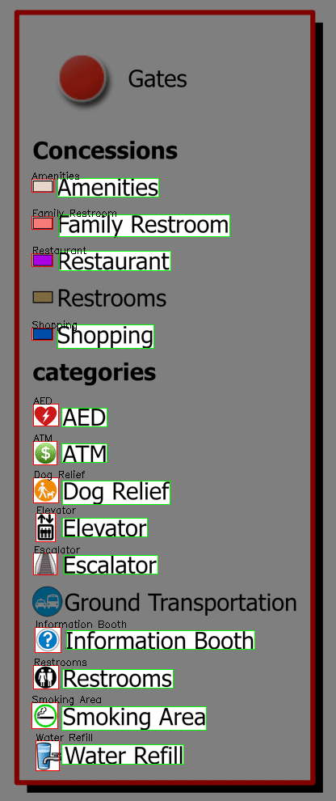
Notes:
From left to right: initial OCR recognition, symbol text cleaning, connect symbol text, final result.
Points to note:
In initial OCR recognition, symbols and texts of (Amenities, family restroom, restaurant, restroom, shopping, ground transportation, information booth and water refill) are connected, because they are too close to each other, and closing kernel is 5 horizontal pixels.
However, in symbol text cleaning part, texts are connected horizontally and newly connected components re-OCR’d, this increases the recognition accuracy, for example, the symbol of escalator is recognized as an ‘A’ before, now it’s a symbol. This cleaning step also split the symbol texts, so that most of connected symbol-text bounding boxes are now separated, like Amenities, family restrooms, restaurant etc. but not restrooms and ground transportation. After text symbol split, their bounding boxes are refitted, such as family restroom, restaurant etc.
In this step, text bounding boxes search leftward, rightwards and upwards looking for symbols, then choose the one with the most symbol-text pairs after removing outliers. In this example, the remaining one is searching leftwards. Also note that the searching boxes stops at the walls (which are recognized in the first step, this helps reducing FPs, such as symbol-text pairs across walls, or texts connected cross walls, that shouldn’t happen but made possible because I remove the walls) (I remove the walls in the first step to prevent text connecting to them in the closing step)
Final result

Slide 9
Evaluation
For each symbol-text pair, calculate their Jaccard index (JI) with the true bounding box.
Calculate text similarity of recognized text with the true text.
TP if JI(symbol, true_symbol)>0.3 and JI(text, true_text)>0.3 and similar(text, true_text)>0.8
FP if any of the above fails
FN for all symbol-text pairs in true labels that are not TP or FP.
Notes:
Threshold of symbol JI is low (0.3) because sometimes recognized symbols are larger (includes the true symbol), such as ‘symbol ---’ (symbol with a dash) should be a match with ‘symbol’
Don’t worry if text JI is low, because if the text bounding box doesn’t contain the correct text, it will fail in text similarity check (so JI(text, true_text)>thres is not actually needed, just realise now… but no harm keeping it.)

Slide 10
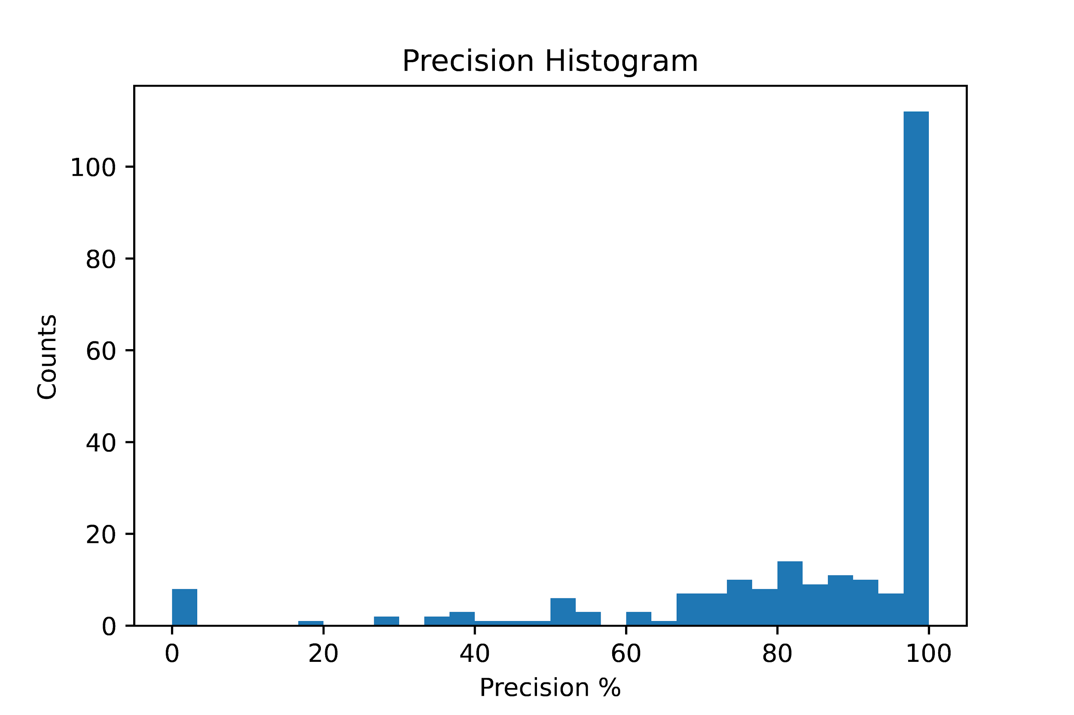
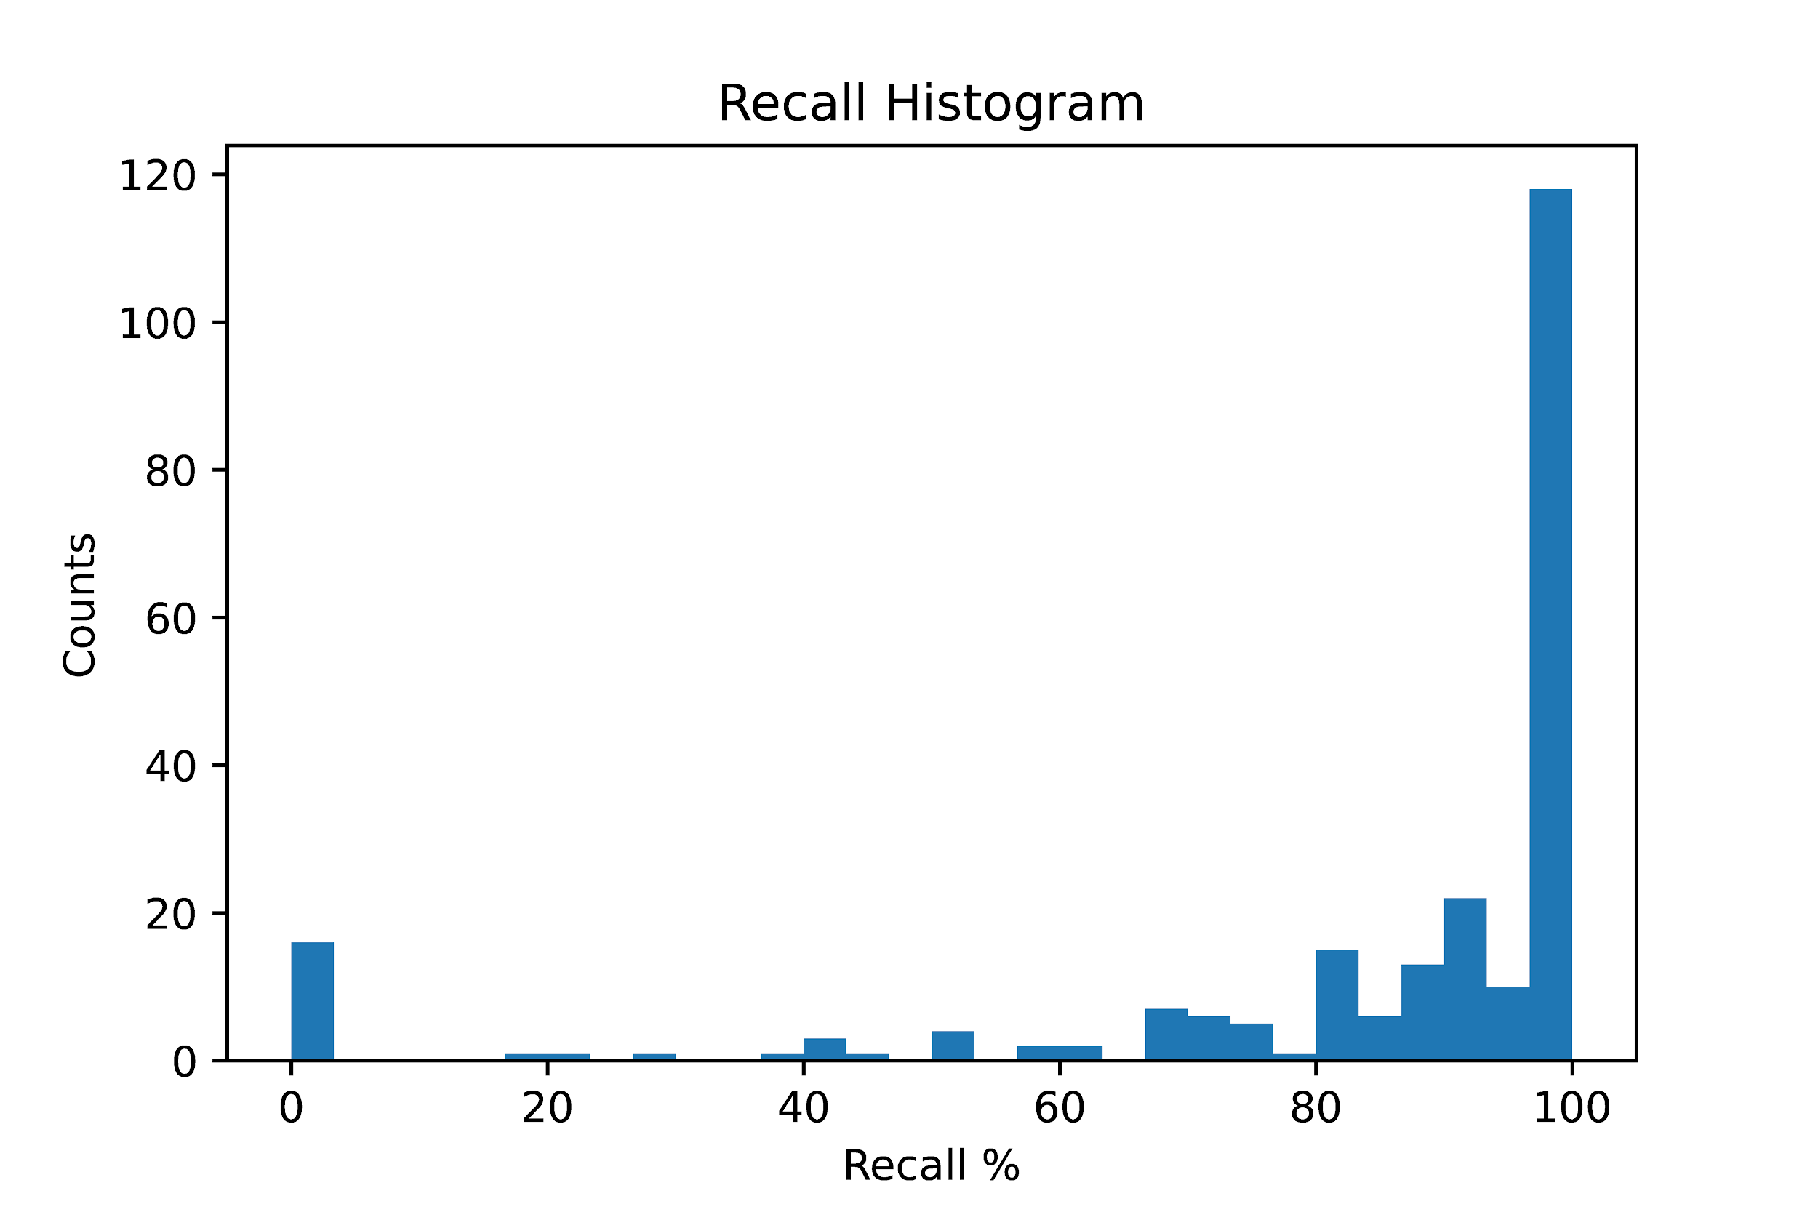
Summary of findings
Created a legend detection tool,
Created a small corpus of public space floor plans with legends,
The tool achieved 83% precision and 88% recall tested on the corpus,
This tool do not perform well on low resolution images, or images containing mixed types of legends.

Slide 11
Conclusions
In this project I created a legend detection tool and a corpus of floor plans with legends.
This tool can be used as a baseline for later researchers on similar topics.
Legend detection can then be used to generate accessible graphics.
Learning based methods or table (without borders) recognition methods may be used for a potentially better recognition result.
Notes:
At some stage I realized that do a research on table recognition methods may be better, but I had already started coding so it was too late to change anyways.

Slide 12
References
[1]
D. Doermann, Handbook of document image processing and recognition, London: Springer, 2014.
[2]
A. MADUGALLA, "Generating Accessible Online Graphics for Visually Impaired People: A Case Study with Floor Plans," Monash University.

Slide 13
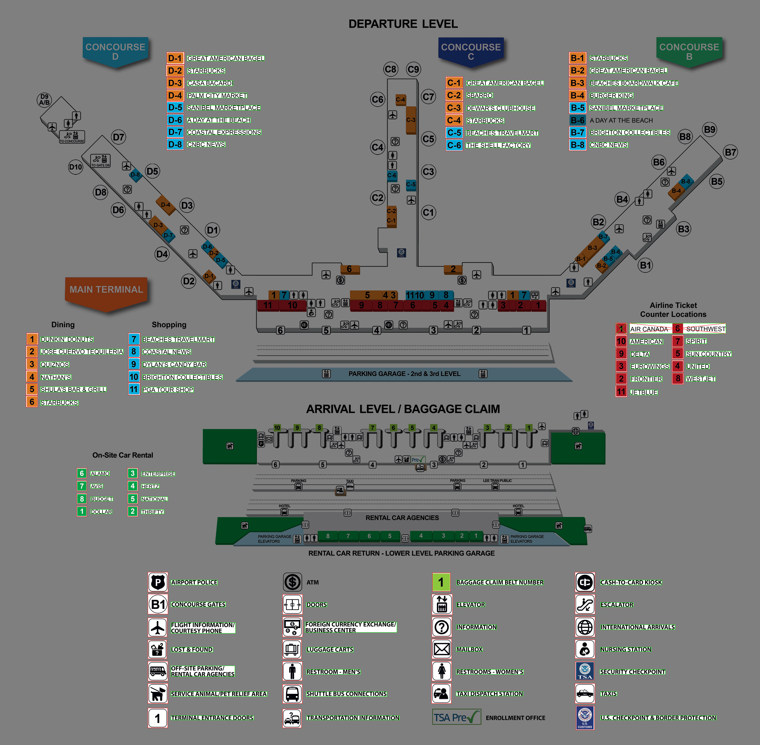
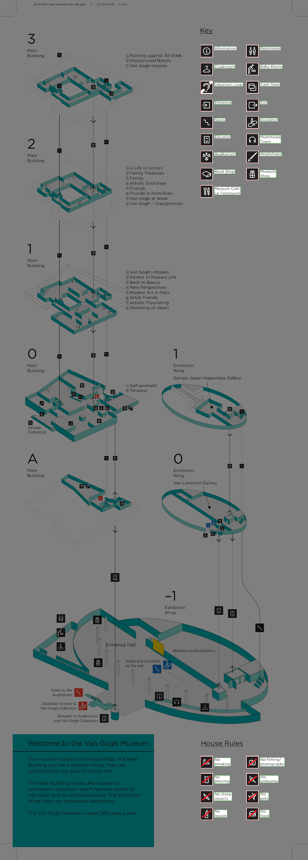
Images

Slide 14
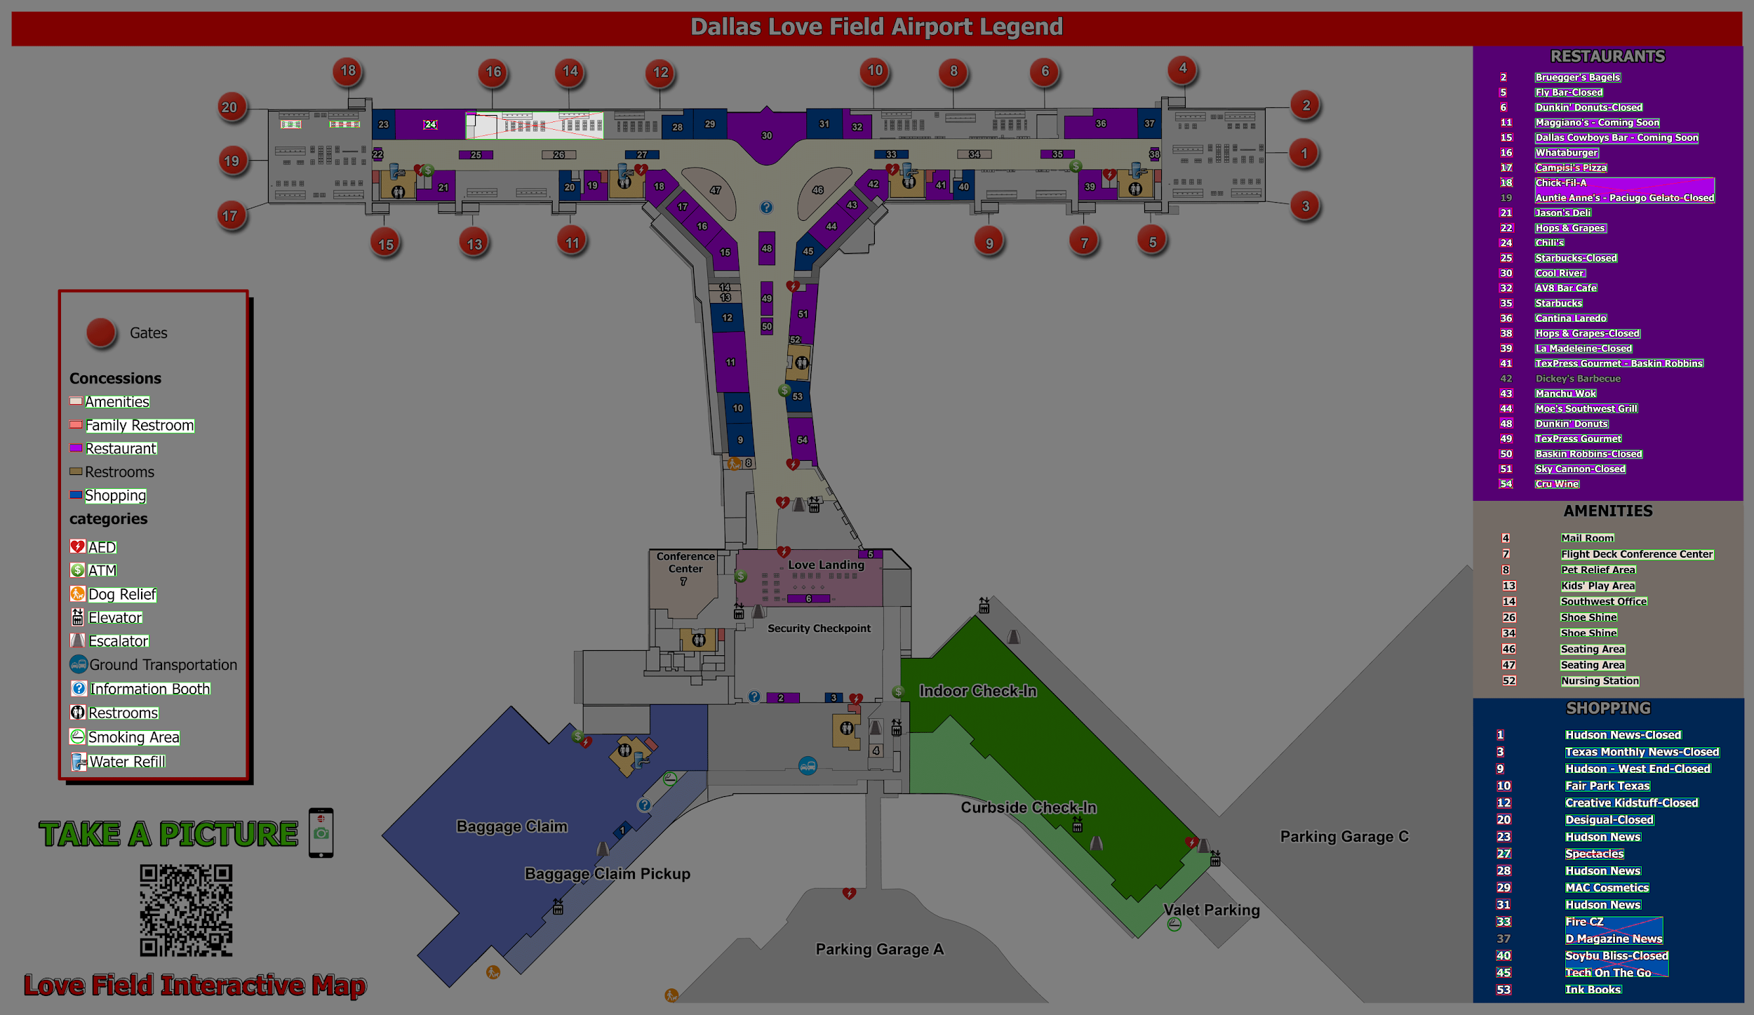
FPs
FNs

Slide 15
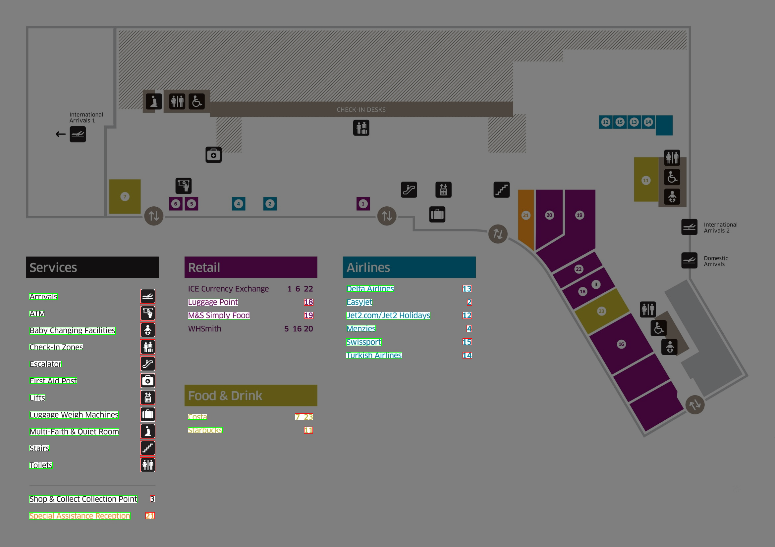

Slide 16
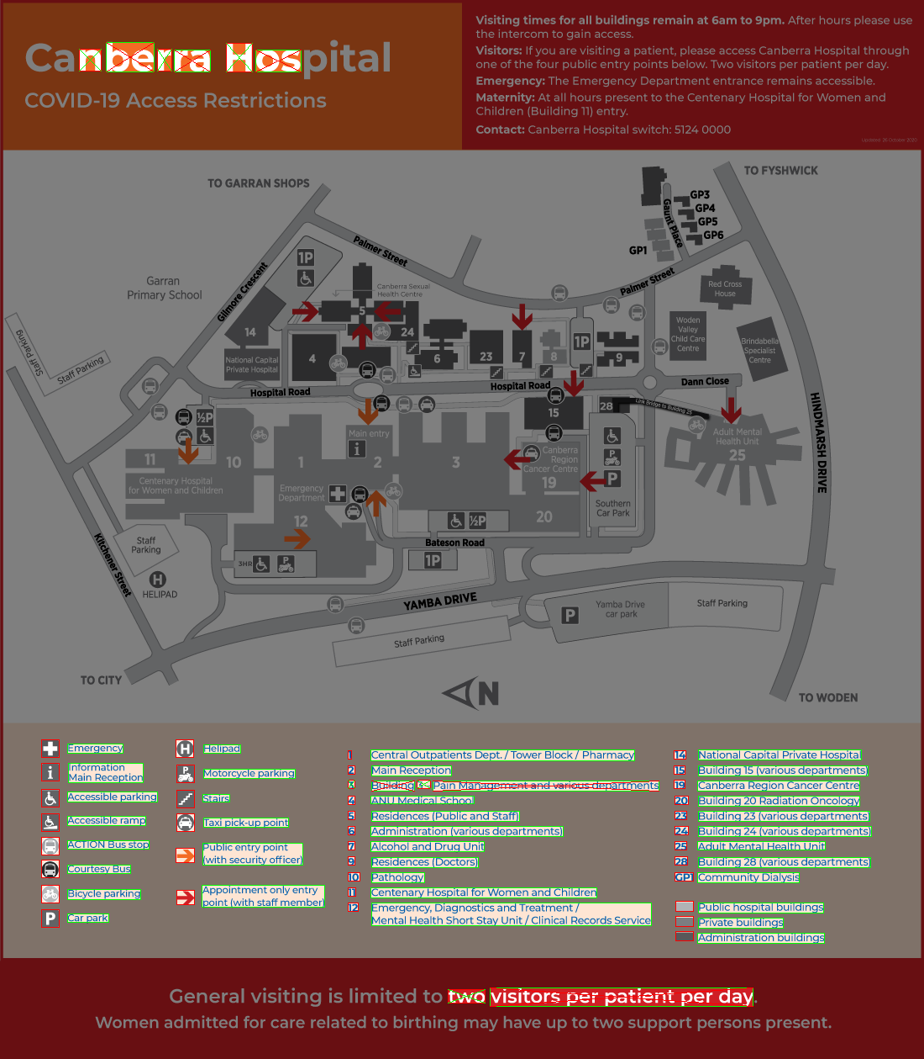
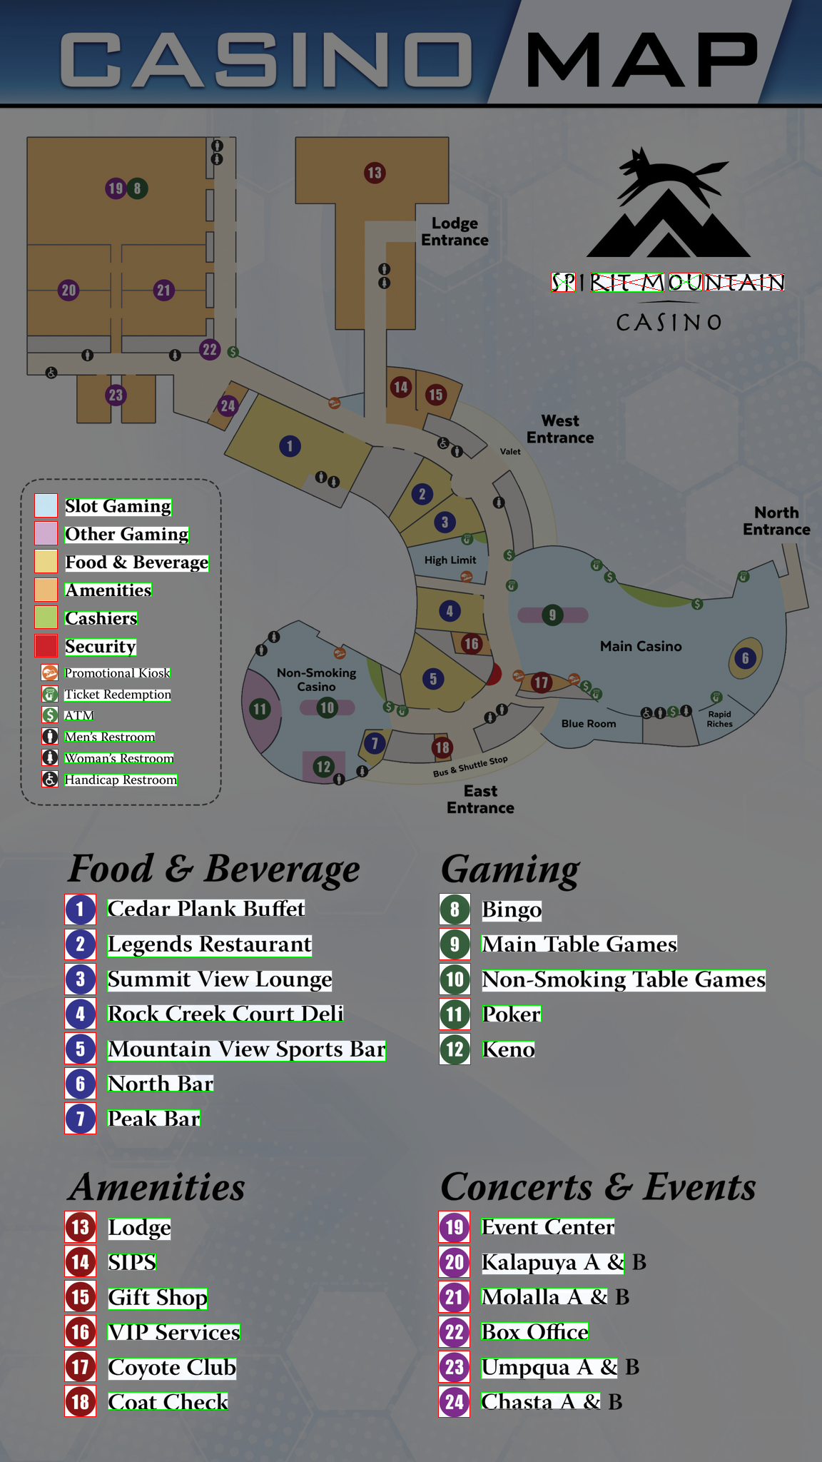

Slide 17
Student bio
My name is Yu Hou and I’m a final year master of data science student at Monash University. This is my 10-week summer scholarship project.

